Slide 1
For sale 5440 Channing road Baltimore, md (county) 21229 3br, 2f/b $155k with a $40k forgivable 2nd mortgage Listing Agent Candis Carr at ExecuHome Realty (410) 654-0202 or candis_carr@yahoo.com http://mrislistings.mris.com/DE.asp?k=3323457X5F62&p=DE-345043540-168
Within minutes of downtown, close to BWI, route 40 & I695
Convenient to several shopping centers, schools, parks & transit
This home is available for sale to buyers who earn upto 80%of the median income. Homeownership education is required, contact a Baltimore County Hud-approved Housing Counseling Agency.
Household Size | 1 | 2 | 3 | 4 | 5 | 6 | 7 | 8
Income Limit | $46,000 | $52,600 | $59,150 | $65.700 | $71,000 | $76,250 | $81,500 | $86.750

Slide 2
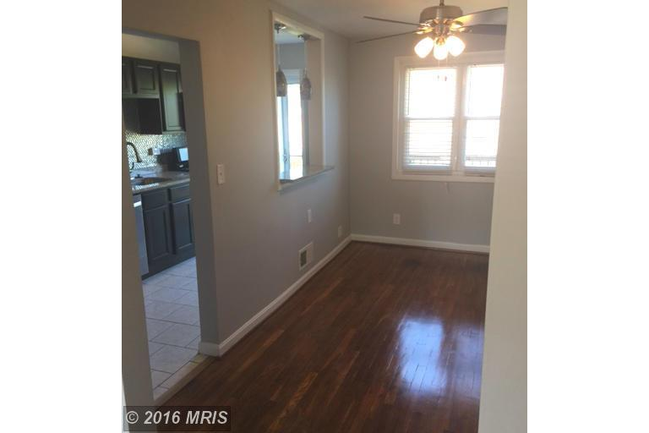
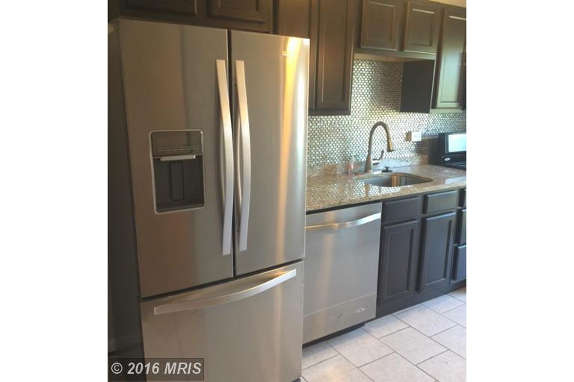
New Roof & Doors & New stainless Kitchen

Slide 3
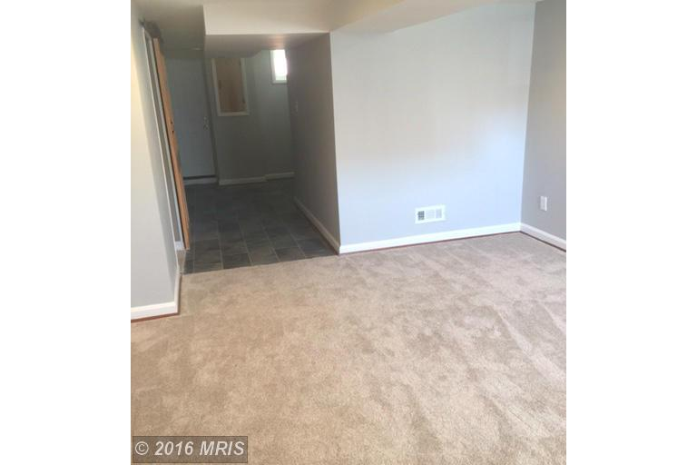
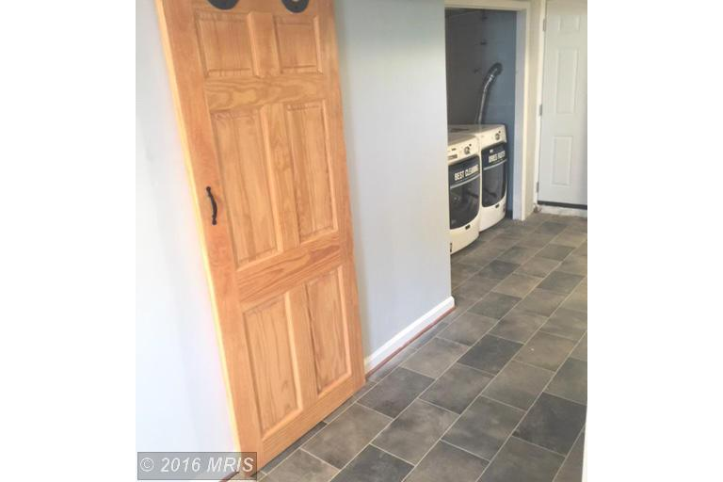
2 full baths and finished basement

